Slide 1

Fictious Airways
How we improved flight safety.

Slide 2
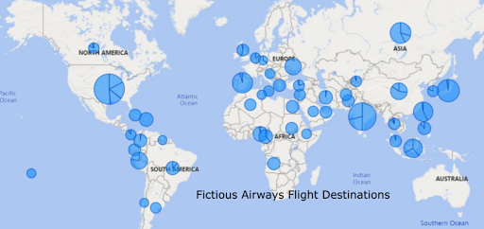
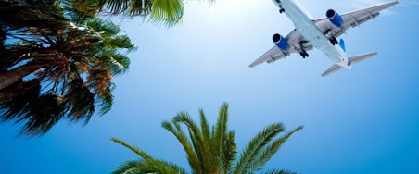
Who are we? And where have we been?

Slide 3
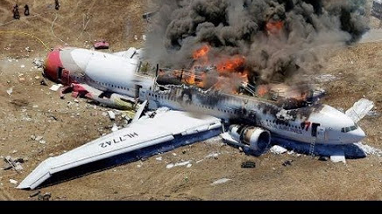
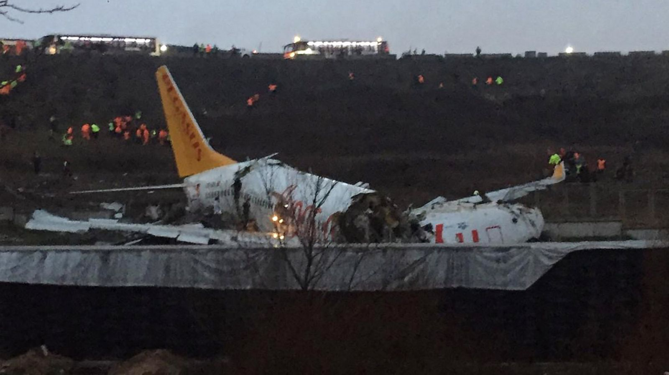
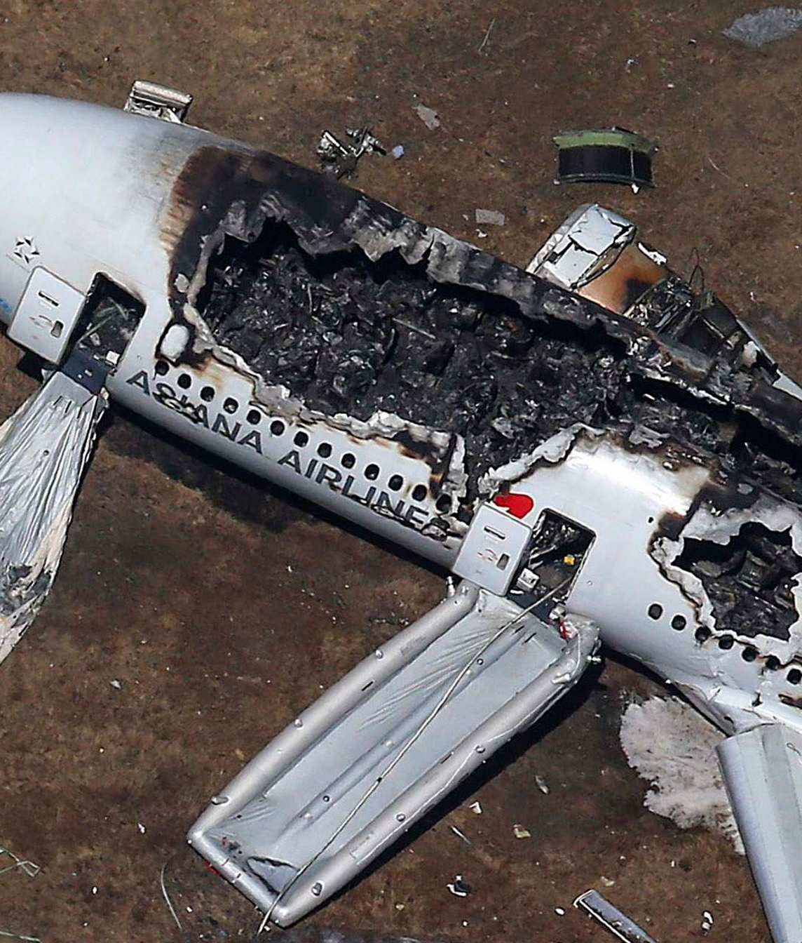
As news of crash fatalities become more publicized our company dreams become nightmares.

Slide 4
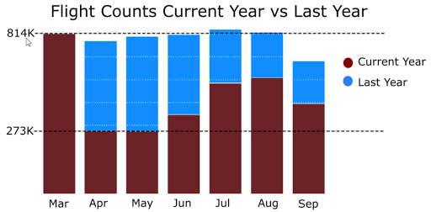
How has safety concerns impacted air travel?

Slide 5
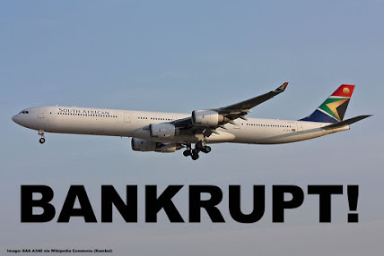
With fear of travel comes our fear of bankruptcy.

Slide 6

A new Data Science team was assembled to assess the problem and identify a solution.

Slide 7
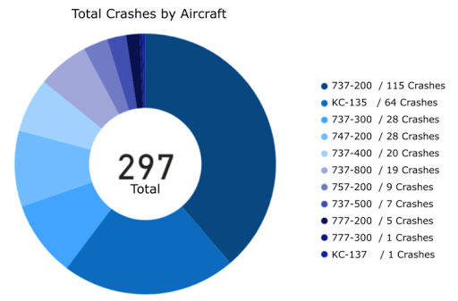
How many crashes has each aircraft been involved in?

Slide 8
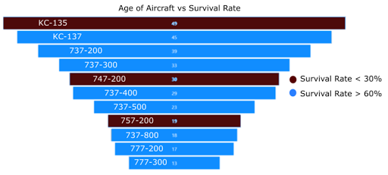
Does the age of our aircraft contribute to crash fatalities?

Slide 9
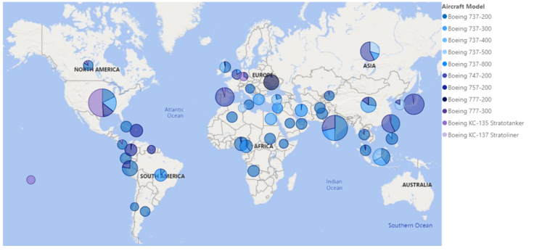
Does the location affect the crash fatalities?

Slide 10
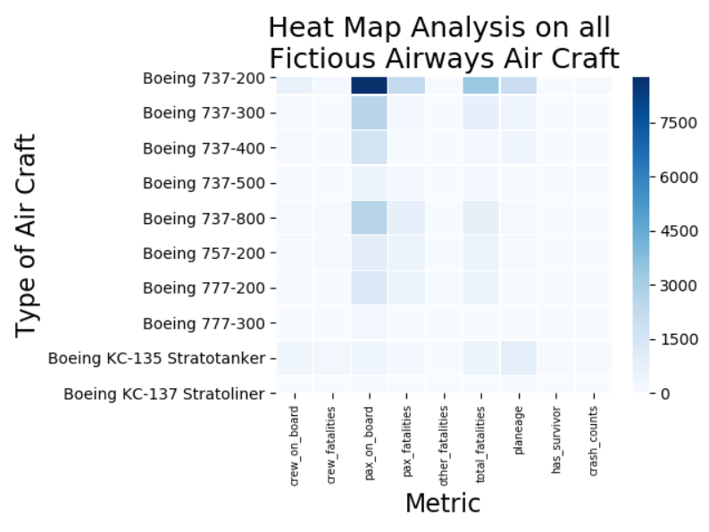
What do our recorded crash metrics tell us about our aircraft?

Slide 11
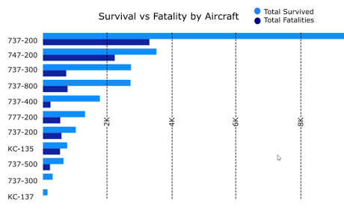
Is there a pattern with specific types of aircraft that contribute to the ratio of chances of survival over fatality?

Slide 12
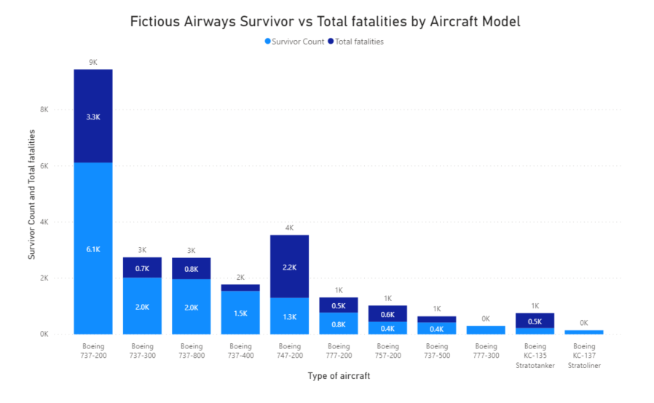
How does our survival counts stack up against fatality counts?

Slide 13
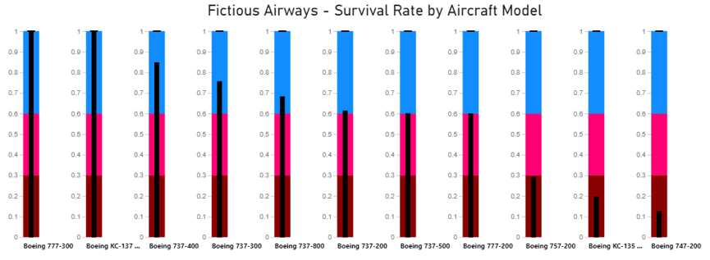
Revealing the new survival rate metric for each aircraft.

Slide 14
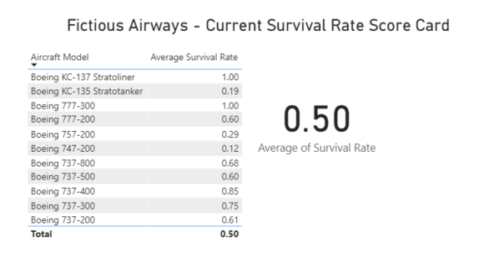
How does this new survival rate metric contribute to Fictious Airways’ overall survival rate?

Slide 15
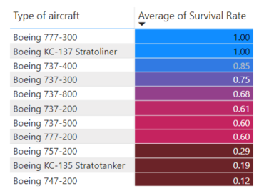
How we improved our survival rate? Which aircraft should be targeted to be removed to improve overall survival rate?
Aircraft to decommission:
Boeing 757-200
Boeing KC-135 Statotanker
Boeing 747-200

Slide 16
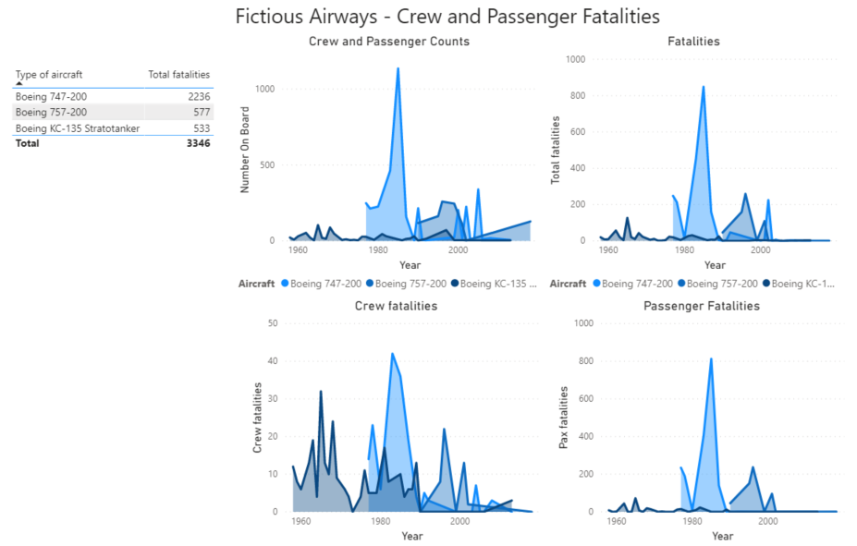
How did we further assess the aircraft identified for decommision?

Slide 17
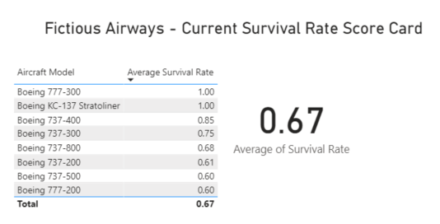
How does the overall survival rate look after removing the identified aircraft?

Slide 18
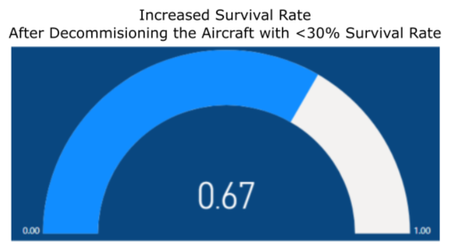
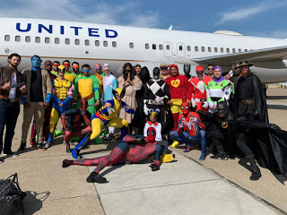
Improved Survival Rate!

